Slide 1
Eye-tracking glasses
DAPP Group 3

Slide 2
Key components
Camera & Eye-tracking
UI design
CPU
Text-to-speech generator
IMU sensor
Batteries
Visual display and microphone
Frame

Slide 3
Flow chart
Frame
Camera
Google glasses (Display)
CPU
UI
OS
ML Model
Microphone
IMU
Interlo-cution

Slide 4
Camera and eye-tracking
Motion, direction and blink
Sampling from one eye will probably be enough
Trace the continuous-time motion and need to record the event up to a few seconds
Apply filters and remove glares
Figure out where and how to place the camera

Slide 5
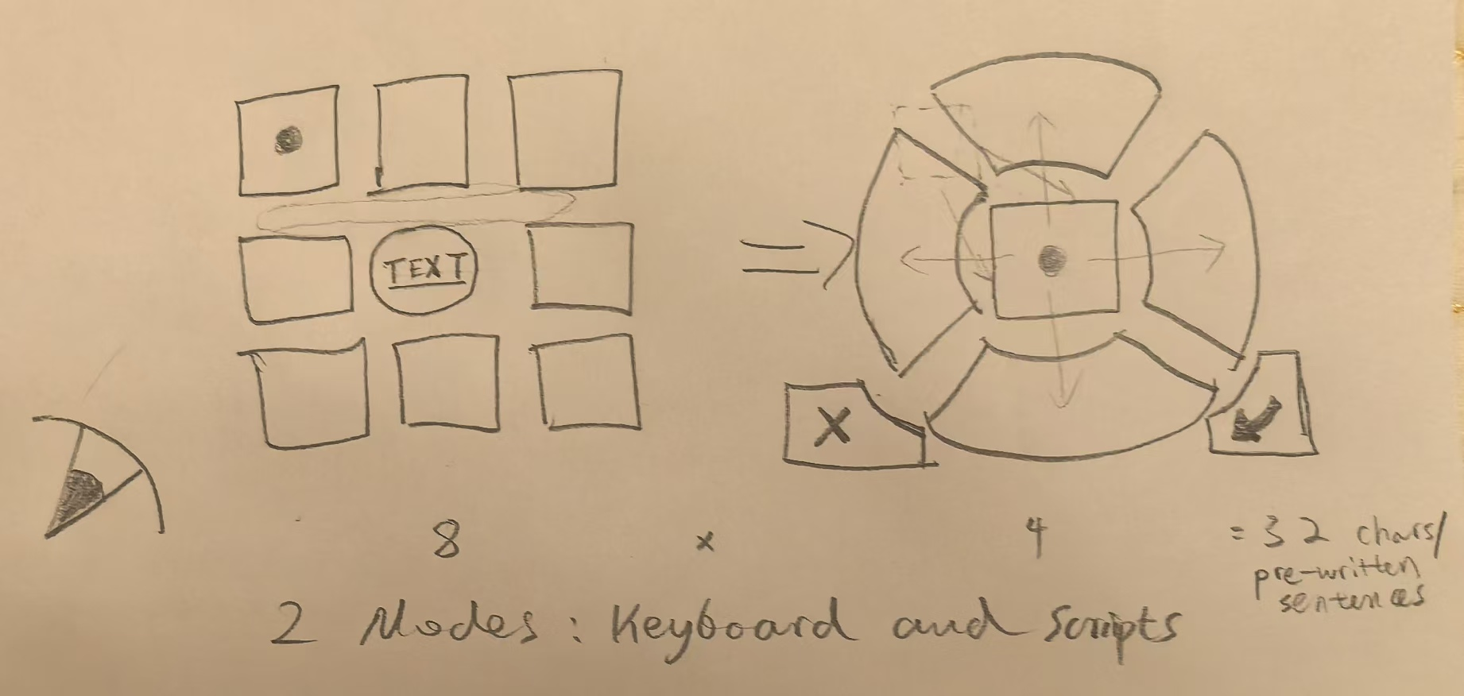
UI design
Interface design and programming
Two modes, one for typing and one for pre-selected scripts
Two panels, one has 8 directions and the other has 4, which further specifies the choice
Need to be interactive, learn from the existing body of software and website design knowledge
This should be a small and complete OS program stored in the CPU like your Android/Apple/Harmony powered mobile

Slide 6
Text-to-speech generator
Generate sound files that can be directly played by the mic
Ideally, this could be a small-to-medium sized ML model that is being trained on the patient’s data (one of our teammate’s)
The model’s parameters are stored in the CPU, may need to write a small script to prepare the model’s output into proper sound file
Alternatively, if that’s shown to be too difficult, we use the existing platform that has a ready-made solution

Slide 7
IMU
Pick up on the user’s head movements and convert into commands that supplement eye motions
Need to decide on how we should define and encode different commands, how they correspond to the movements intuitively
Will need to write a small script to process the data
How to place? Where to purchase, and what type?

Slide 8
CPU
Raspberries Pi or others
Low-level programming, coordinating the camera & IMU (hardware) and UI & Text-to-speech (software)
Manage data stream and perform computations
Will probably need several programming languages for the system-level design
Need to consider our needs and specifications realistically, don’t need excess hardware power

Slide 9
Batteries
What should we use for our final product?
What should we use for our demonstration?
Load-line and consideration over the device’s power consumption
Charging speed, duration of use and battery life
Heating and cooling, cannot exceed 41 degrees in exterior

Slide 10
Display and microphone
No. 1 choice is to directly plug into the Google glasses to do the job
Need to figure out the hardware

Slide 11
Frame
Mechanical design (hard hardware)
CAD and 3D printing
Integrate all components abovementioned
Our test version just need to put everything together for testing
Our later version should consider aesthetics, efficiency, safety, etc. (We could only do this once we have decided the model/type of other components)
If we need to use the Google glasses, consider how to embed it into our frame

